Slide 1
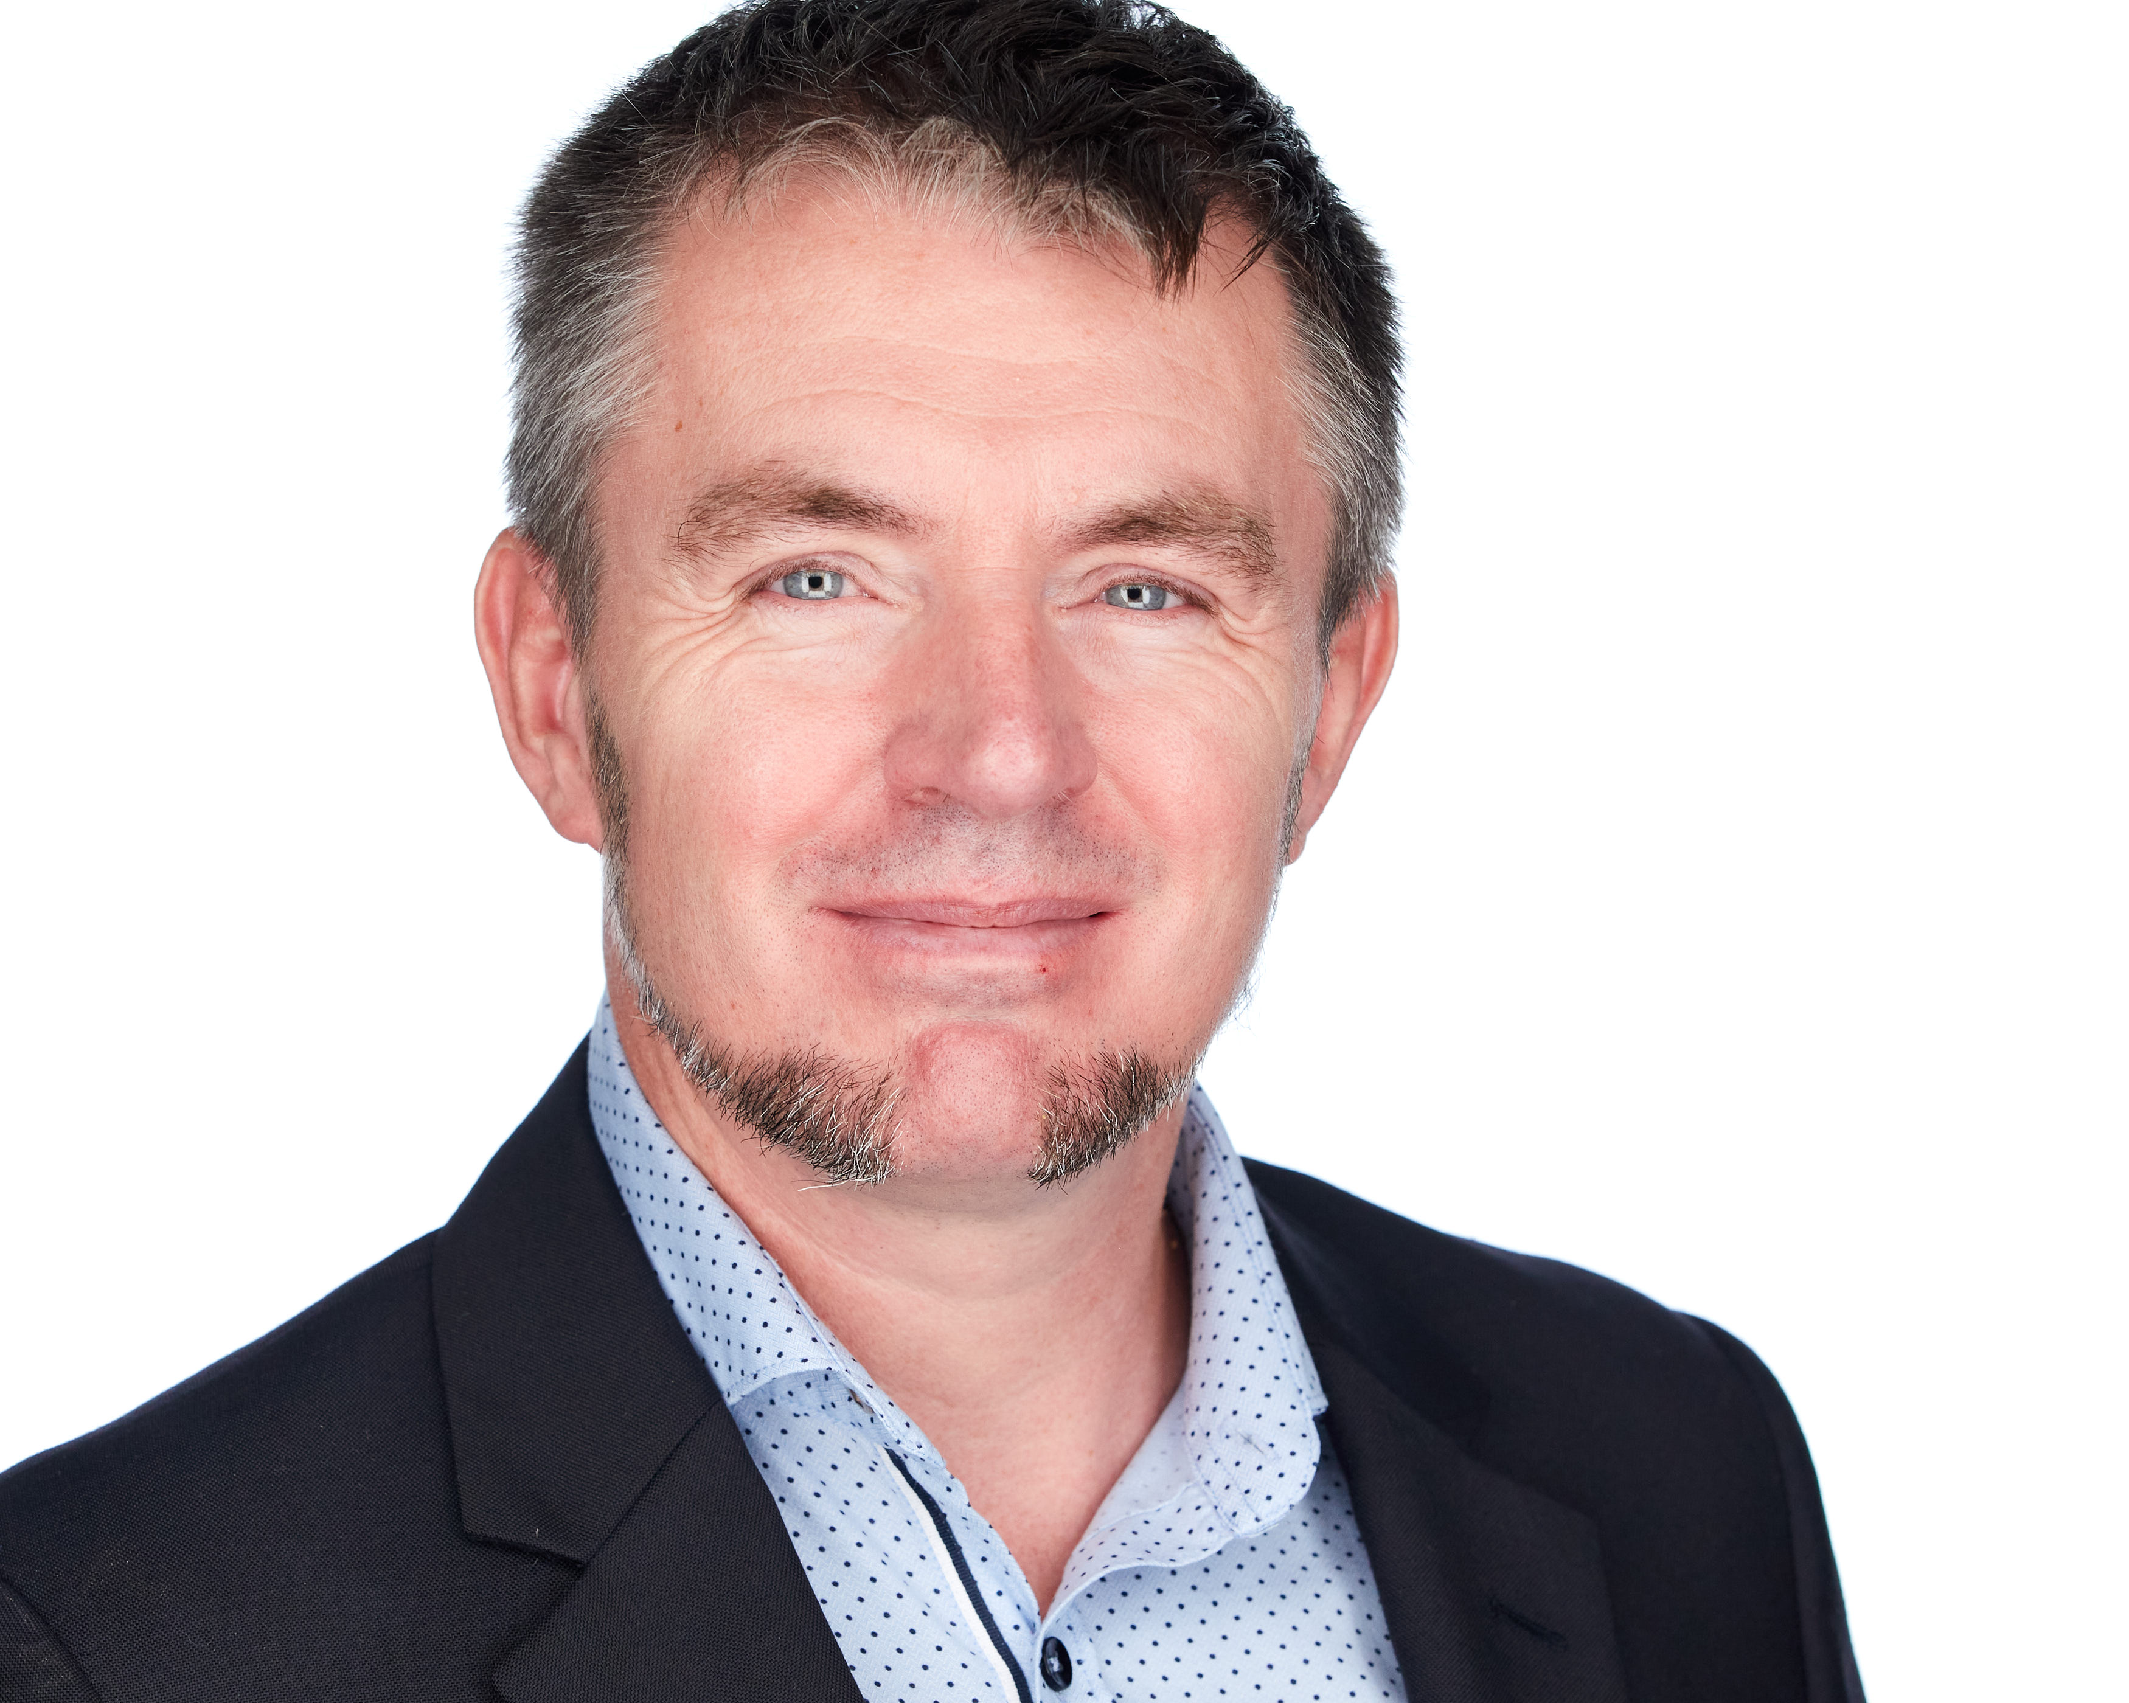





JON-PAUL BOYD
Intelligent Systems Engineer
I thrive on delivering tangible, cutting-edge, AI-enabled and analytic solutions that inform, empower & perform. I help solve business challenges and deliver value to all stakeholders through strong theory, experienced hands-on, clarity of thought and communication.
+41 (0)79 952 18 81 jp@corticalstack.ai corticalstack.ai jonpaulboyd Nyon, CH
CAREER HIGHLIGHTS
EDUCATION
STATS
SAP HANA Technical Architect
Nestle | Vevey, CH | 2014 – 2017
Technical lead, inspiring team implementing groundbreaking HANA-based analytics reporting solution. Empowered 3000 users with multi-level recipe search to answer questions of regulatory compliance, quantity & procurement previously impossible. Learned I’m still hungry for technical challenges.
Resolved SAP product shortcomings, developing tool for analytic privileges build & assign, enabling project go-live.
Quantified performance, developing tool measuring query runtimes vs KPIs, supporting user experience & expectations.
Led configuration of HANA workload management, HALM & HRF, acquiring required skillsets & sharing with team.
Major contributor to Nestle HANA dev best practices.
Led 5 HANA major upgrades & migration of analytics sidecar to embedded NetWeaver/HANA dual stack.
Daily liaison with stakeholders, technical & product teams.
SAP HANA Technical Architect
Bluefin Solutions | London, UK | 2014
Helped BAT realise Gartner’s Logical Data Warehouse concept by implementing HANA SDA for data federation of London & Sydney databases. Learned trust won on transparency & keeping delivery promises goes a long way.
Developed P&L with sub-second performance (legacy 2m10s), SAP Fiori KPI dashboard with line item drill-down.
SAP HANA Technical Architect
HANA Propulsion Laboratory| Blonay, CH | 2013
Learned HANA by engineering piloted vehicle, with real time telemetry to cloud-hosted dB for analytics & vehicle control via openUI5 cockpit. Realised benefits of deep & wide research.
Data mining for game analytics & achievement/reward system tied to mission objectives & pilot behaviour.
SAP Web Dynpro ABAP Consultant
Nestle| Vevey, CH | 2010 – 2013
Hired to solve skillset deficit, lead for complex development, problem-solving & upgrades. Learned greater self-belief & improved interpersonal skills through learning from others.
Brought sophisticated recipe change doc concept to life with UI design driven by simplicity, familiarity & customisation.
Delivered technical training for offshore teams.
SAP ABAP Consultant
Belgian Railways| Brussels, BB | 2008 – 2010
With a natural team-lead expertise, successfully rescued a failing technical project to deliver integration of RF scanning into warehouse management shipment handling. Learned love of OO dev & software in physical systems.
Individually responsible for complex bespoke development functionality within logistics execution.
SAP ABAP Consultant
Cap Gemini| Middlesbrough, UK | 2000 – 2008
Senior ABAP dev in SAP competency centre, supporting team’s flagship nearshoring service by analysing customer systems from ABAP perspective to enable the smooth transitioning to SAPrun support. Further demonstrated technical & client-facing capability by delivering additional revenue earning on-site consultancy & training. Learned rewards of coaching juniors.
Work pipeline management and assignment, training and support of 3 ABAP developer colleagues.
Innovated systems integration monitoring dashboard.
Masters Intelligent Systems
De Montfort University | UK | 2017 – 2020
Discovered why stronger partnerships should exist between enterprise and academia.
Applied Computational Intelligence (88%) Predicting customer behaviour with tree-based classifiers. Extensive Python with data profiling & preparation, unsupervised & supervised machine learning, overfitting protection, hyperparameter tuning, model scoring, evaluation & selection.
A.I. Programming (80%)
NLP Python NLTK context-free grammars for natural language to SQL database query.
Data Mining (80%)
Data analysis & machine learning to predict risk indicators for cardiovascular disease.
Neural Networks (80%)
Evaluation of biomass & classification of network activity (intrusion, attack, normal).
Fuzzy Logic (94%)
Classifying breast cancer tumours with fuzzy inference system, outperforming neural networks. Paper being submitted to journal of Applied Soft Computing for publication.
Research Methods (96%)
PhD proposal for augmented analytics.
Mobile Robots (97%)
Virtual search & rescue robot controlled via Python, implementing obstacle avoidance, sensor data fusion, environment mapping, precision navigation, victim location.
Computational Intelligence Optimization (100%) Design & build of Python-based hyper-heuristic optimization platform to address the real-world problem of scheduling optimisation. 5 example nature-inspired metaheuristic algorithms are implemented. A hyper-heuristic feature dynamically switches between low-level metaheuristics to deterministically use the most appropriate algorithm according to current problem state, or select one stochastically.
Masters Project In Progress
Building cloud-hosted medical research cockpit for knowledge discovery, summarization, topic classification & clustering for best-informed next stage research actions, using COVID-19 literature.
23
LinkedIn Recommendations
25
Years software dev
5
Years HANA dev
36
Companies provided expertise
35
GitHub Repos
8
Masters modules graded distinction
12
Times consulting contract extended
1
Individual delivering client centric excellence
TOOLS
Python
Pandas
Numpy
Scikit-Learn
Keras
NLTK
Elasticsearch MongoDB
SAP HANA
SAP ABAP
SAP Security
ReactJS
JavaScript
Amazon AWS
MS Azure
Docker
Git
GitLab
Linux
Windows 10
PRAISE
“Tech savvy, experienced, meticulous, dependable, ingenious & eager to learn more”
Rudi Dutli, Principal, Infosys Lodestone
“Builds comprehensive understanding of architectures involved, educating & inspiring teams & co-workers in the process. A real flair for challenging, on-the-edge development”
Trond Stroemme, Team Lead, SAP App Expertise Centre, Nestle
“An expert in his domain, a great team player. His focus on results with optimal quality is outstanding”
Norbert Rignall, Master Data Solution Architect, Nestle
AWARDS
Microsoft Certified Azure Fundamentals
AWS Certified Cloud Practitioner

